Slide 1

Sines Framework
Bharath Suresh
Priyanka Ravindra Padwal
Selva Mathew Jeba Seelan

Slide 2

Skeleton :p
Introduction
Existing Landscape
Motivation Begins and Rises
Tech Stack
Architecture
Servers and Agent
What data is collected
Demo Video

Slide 3

Introduction
In this presentation, we introduce a new forensic framework that can minimize the time to response and accelerate the process of evidence acquisition for forensic investigation.

Slide 4

The Existing Landscape
In the digital landscape, detecting a breach takes a very long time.
After an incident is identified, the IR Team first identifies and isolates the affected assets.
After remediation, the Forensic Investigation Team starts an investigation on the assets to identify the cause of the incident, the level of damage and how it could have been avoided.
Typical tools used in such situations are SIEM like Qradar, Log Analysis with Splunk, and Forensic investigation with tools such as Encase and FTK.

Slide 5
The Existing Landscape
We observed that the longer it takes to identify breaches, the more devastating the incident is to the organization.
This leads to more difficulties when conducting investigation and ends up costing more to recover from a breach.
We have repeatedly observed that faster breach identifications leads to faster responses and better insights about the TTP(s) used.
In addition to this, the cost of using high priced proprietary tools can be pretty hard on small-medium sized businesses.

Slide 6

Motivation Begins
We wanted to develop a framework which would perform the following functions:
Create honeytokens to bait threat actors
Log potential breaches
Instruct the associated agents in endpoints to collect initial forensic data
Exfiltrate the collected data to a centralized server for further analysis
Reduce time to incident response
Be Extensible
Encourage Open-Source Contribution
Be Free of Charge.

Slide 7
Motivation Rises
We drew inspiration from some existing technologies and software for our own framework
QRadar, SolarWinds : For their rule-based alerting capability.
Splunk , Solr, Tines : For logging, and workflow creation capabilities
EDRs and XDRs : Automated threat detection and response capabilities
Canarytokens : For creating a bait to entice attackers.

Slide 8

Tech Stack
Python – For servers and agent
FastAPI – For data transfer between servers and agents
Microsoft Office – For creating web bugs (honeytokens)

Slide 9

Framework Architecture

Slide 10
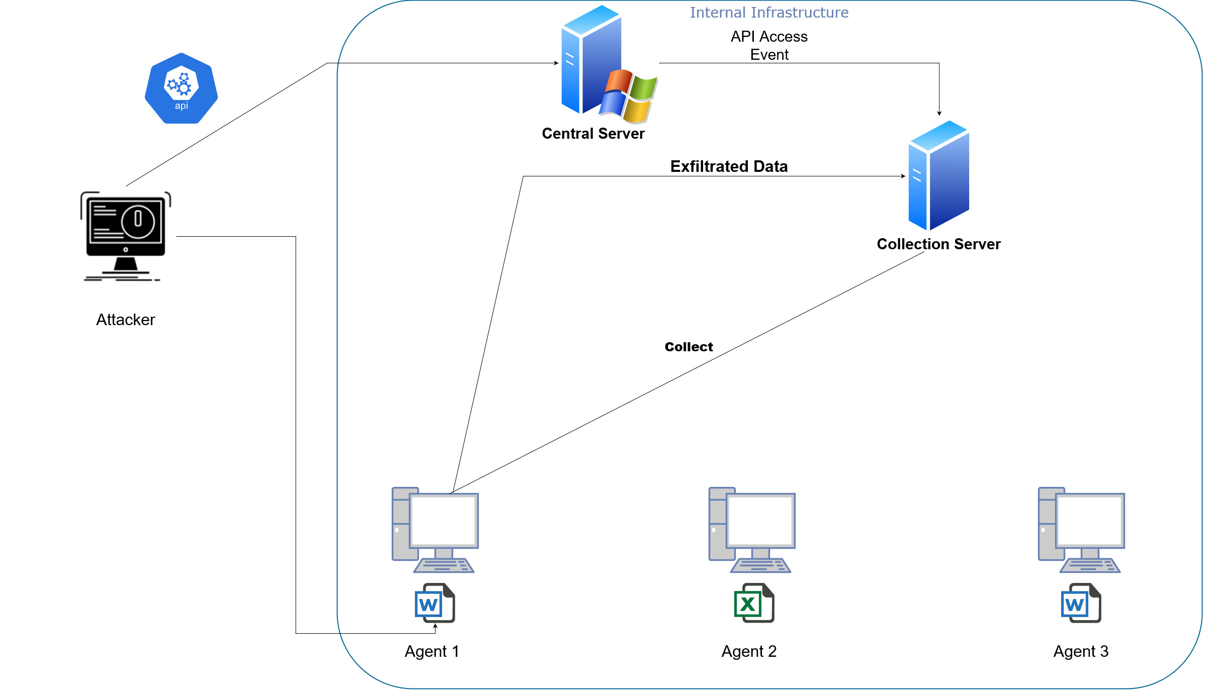

Slide 11
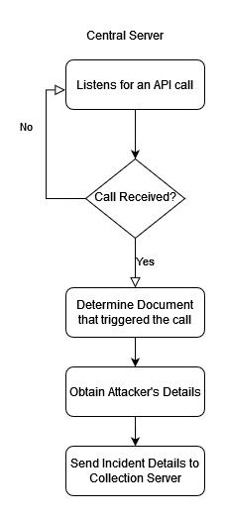
Central Server
Data collected from API call:
Document Tag
IP Address – of attacker
User-Agent information
Timestamp
For every new IP address that accesses a document, this is sent to the collection server in a JSON format.
Notes:
The central server listens to an API call and extracts information from it. The information that is extracted is Document Tag, IP addr of the attacker, user-agent information ( from which appn the document was accessed and when was it access).
When the call is received it determines which document triggered the call and obtain the attacker details,
The details that were described earlier are sent to the COLLECTION server.
Also for every new honeypot accessed from a new IP address, the same process is applied and the data is sent to the collection server

Slide 12
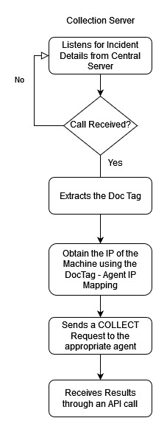
Collection Server
This receives the JSON data from the central server and uses the document tag sent to identify which machine is affected.
A COLLECT request is sent to the corresponding agent and the extracted data from the agent is received and saved in the collection server machine for further analysis.
Notes:
The collection server receives the data from the central server in JSON format. The collection server extracts the document tag from the data that was sent by the central server. On the basis of this document tag we can identify the IP address of the agent/ endpoint from which it is accessed from the DocTag-Agent IP mapping.
It then sends a COLLECT request to that agent and once the data is collected it is sent back to the collection server

Slide 13
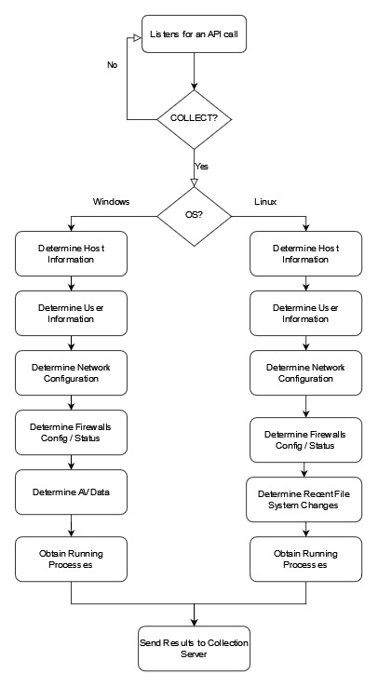
Endpoint Agent
Receives the COLLECT Request
Collects data from the system, converts it to JSON
Send the results to the collection server
Notes:
The COLLECT request that was sent by the collection server runs on the agent and the data is collected and is converted into JSON format. The agent determines which OS is running and accordingly the system information is collected. The data that is collected is explained in detailed in the next slide.
The data that is collected is sent to the collection server

Slide 14
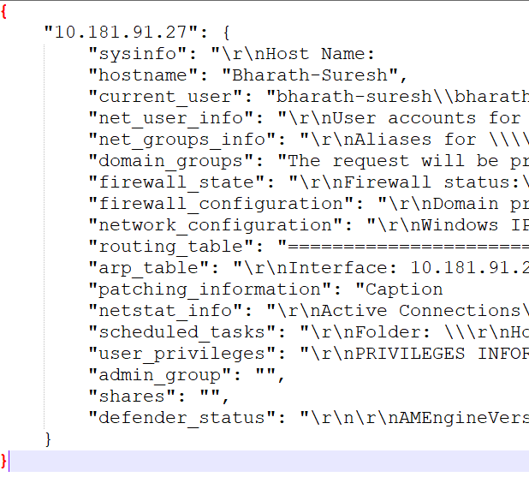
Data Collected from Endpoint Agents
We collect basic information about the OS, IP Address, Hostname, Network configuration and connections, Process information, Login information, Latest modified files, Connected users, Antivirus and Firewall configurations and Shares.
Example from a windows agent machine.

Slide 15

Demo

Slide 16
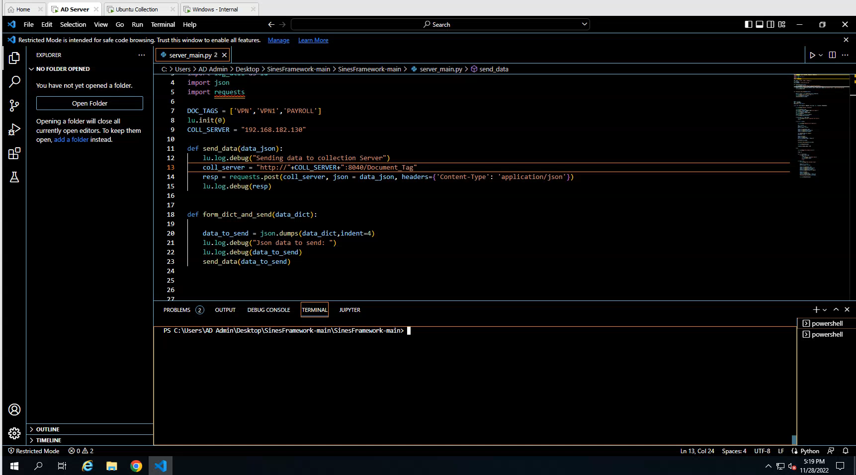

Slide 17

Future Work
Implementing a database to store the data – Motivation: the SQL
Host Isolation
Memory dumping from the agent machine
Implementing a rule-processing framework

